Slide 1
Impact Location Assessment using k-NN and DTW
Goal: demonstrate that k-NN and DTW algorithm can be trained and used to classify test data from quadcopter in 3 formats:
  Hover
  Impact Back Right
  Impact Front Left (opposite corner of back right)

Slide 2
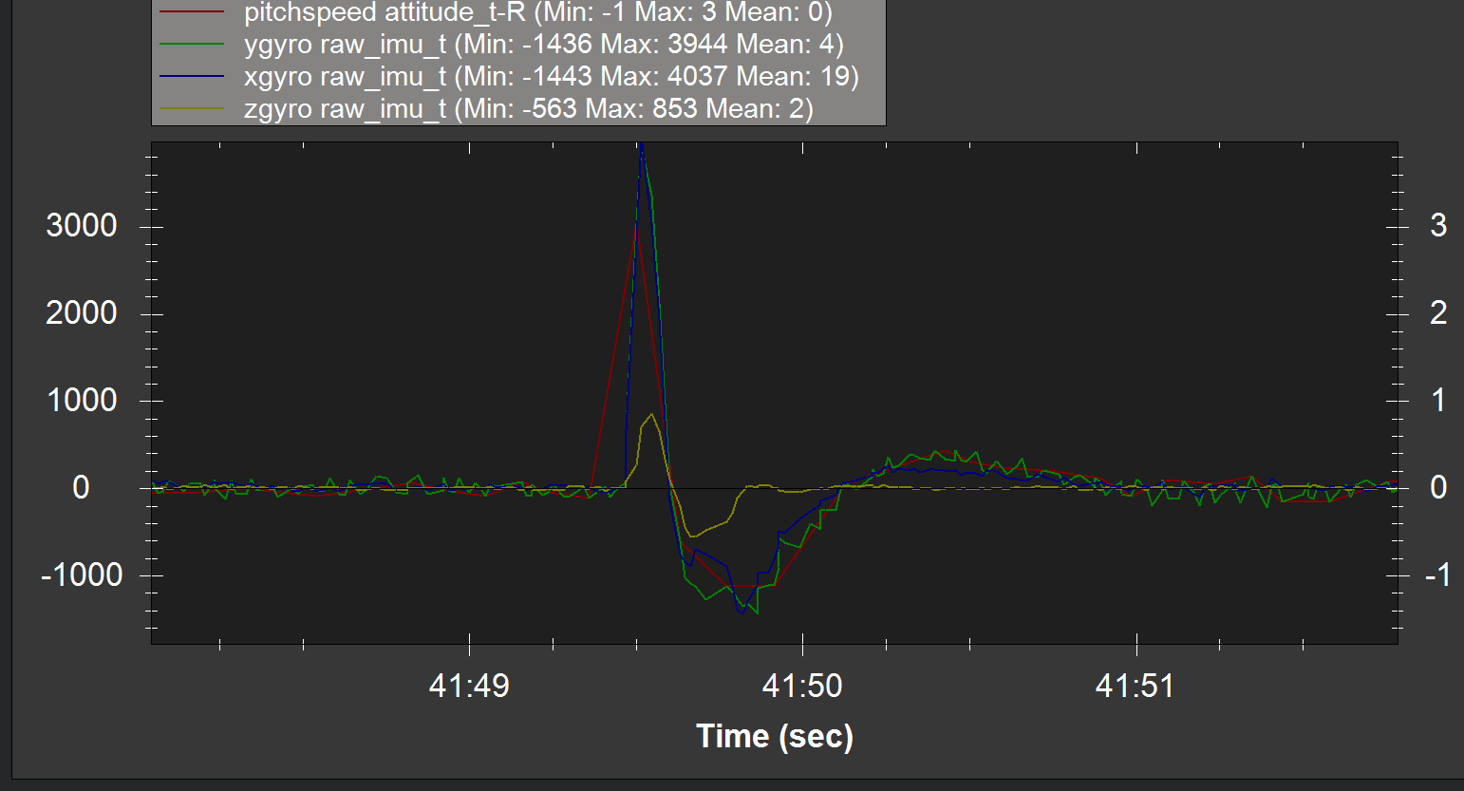
First Question: Is high speed data necessary? (green = 50hz, rest = 10 hz)
Maaaaybe…..Start with the 50hz data (imu data) and can always decimate as needed.

Slide 3
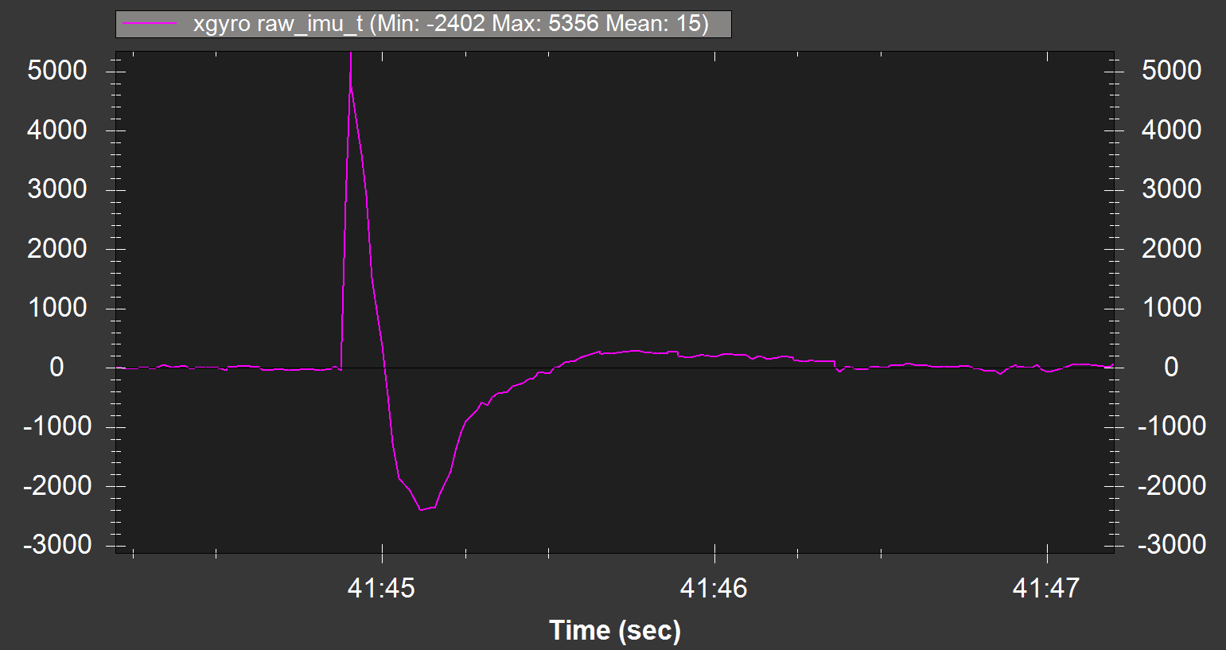
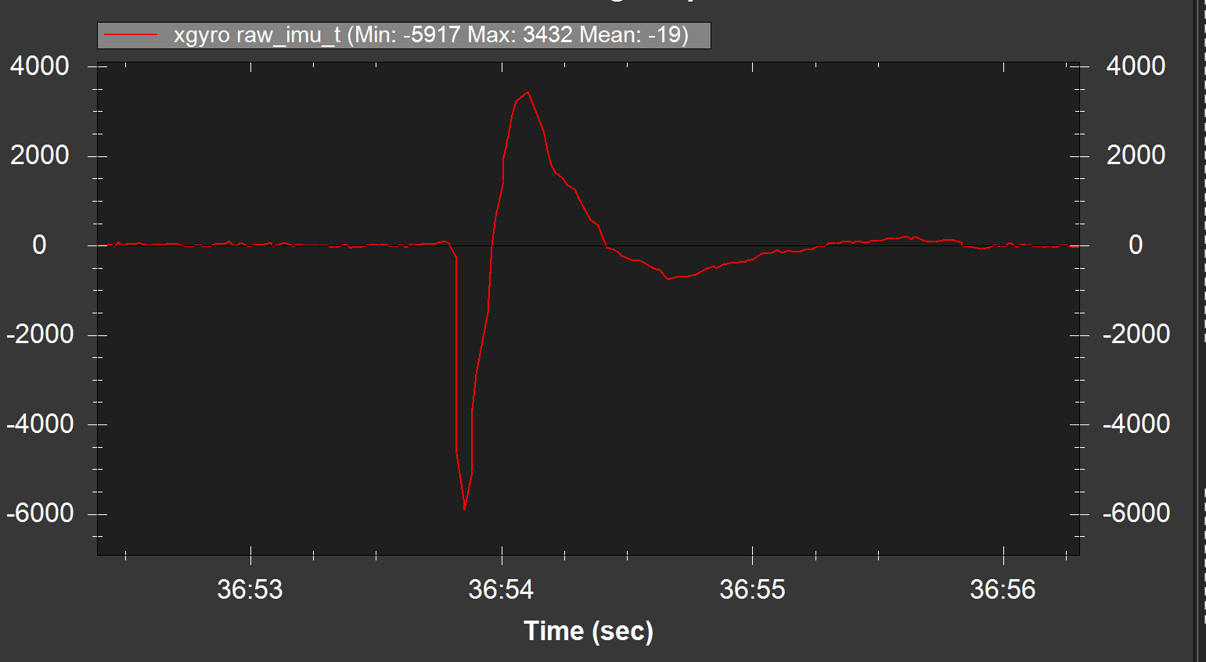
Difference in waveform
Front Left Rotor Impact
Back Right Rotor Impact
Waveforms appear as nearly identical inverses of each other.

Slide 4
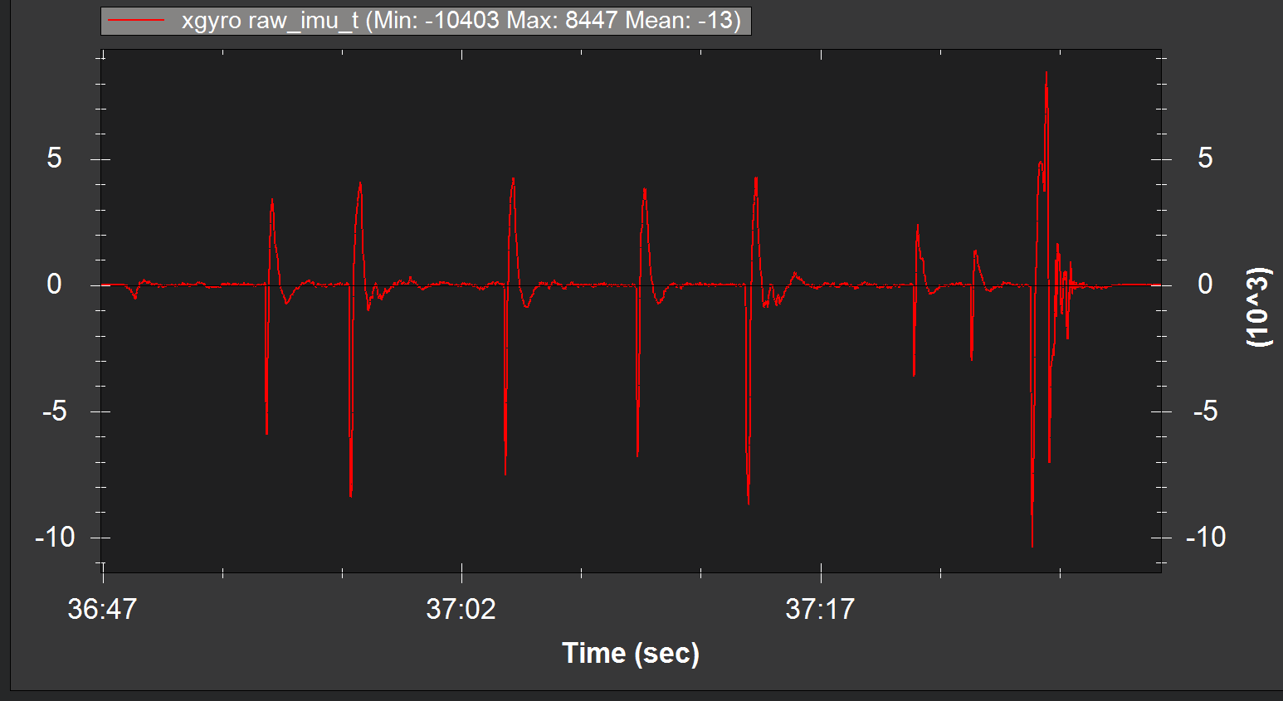
Full Data to be Spliced

Slide 5
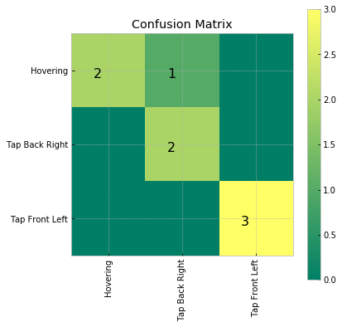
Data tested with k-NN and DTW
15 total time series (50 hz xgyro):
  4 hover
    2 train
    2 test
  6 tap back right
    3 train
    3 test
  5 tap front left
    2 train
    3 test
runfile('H:/.spyder/Quadcopter_Tap.py', wdir='H:/.spyder')
[****************100%******************] 48 of 48 complete precision recall f1-score support
Hovering 1.00 0.67 0.80 3
Tap Back Right 0.67 1.00 0.80 2
Tap Front Left 1.00 1.00 1.00 3
avg / total 0.92 0.88 0.88 8
￼
One of the Back Right Taps was confused with a Hovering…?

Slide 6
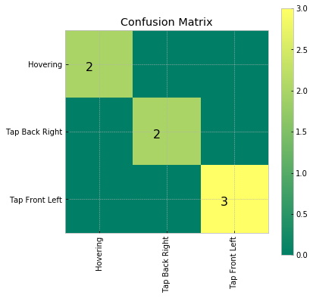
Which One was confused?
Yup, it’s that one
Shorter time series would probably fix this, or more training examples. I just
Grabbed 150 samples for all the timeseries (3 seconds). Much too long in hindsight.
Removing it get’s them all, no confusion!

Slide 7
Thoughts:
Time: For the test, this is 6 training samples by 8 test samples, 48 DTW calculations. The HAR dataset was like 217,000! Running only 48 is nearly instantaneous. Also each timeseries is much shorter.
Multiple Parameters?: I’m wondering about just adding other parameters to the training and test data sets for the same anomaly. We could then make it smart and maybe say xgyro was an OK hit, but ygyro was really strong therefore it is a front right tap or w/e. This is probably a dumb way of doing it but it could probably work.

